Slide 1


Value Stream
Description
Project Name
This is the default screen, that user will see when user starts the VSMAP app
Current Value Stream
Text
Future Value Stream
Project Team
Compare
Name 1
Function
Name 1
Function
Improvement Steps
Name 1
Function
Name 1
Function
Value Stream Description
Symbols
Text
Symbols tab will be inactive other than value current / future stream screen

Slide 2
Project Name
List of Projects
Text
Start New Project
Project Team
Send as PDF
Name 1
Function
Send as VSM
Name 1
Function
Name 1
Function
Name 1
Function
Value Stream Description
Text

Slide 3
Project Name
List of Projects
Text
Create blank project
Start New Project
Project Team
Create project from template
Send as PDF
Name 1
Function
Send as VSM
Name 1
Function
Name 1
Function
Name 1
Function
Value Stream Description
Text

Slide 4





Value Stream
Description
Current Value Stream
Future Value Stream
Compare
Improvement Steps
Symbols
Process
Material
Information
General
Extended

Slide 5
Improvement Steps
Step 1
Step 2
Step 3
Step 4
Step 5
Step 6
Step 7
Step 8
Step 9
Step 10

Slide 6
Compare
Current Value Stream
Future Value Stream

Slide 7
Compare

Slide 8
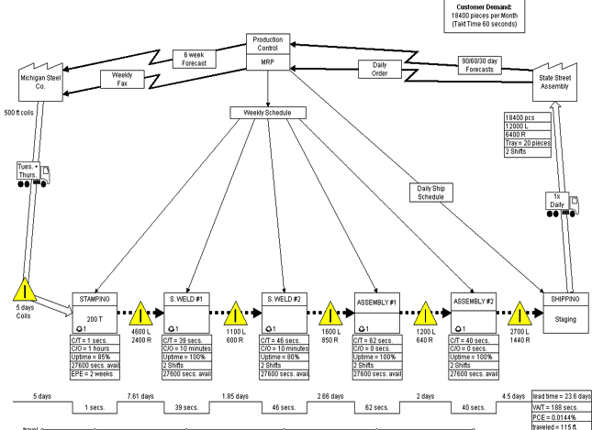
Value Stream
Description
Example
Current Value Stream
Future Value Stream
Compare
Improvement Steps
Symbols
Process
Material
Information
General
Extended

Slide 9
Value Stream
Description
Example
Current Value Stream
Future Value Stream
Compare
Improvement Steps
Symbols
Process
Material
Information
General
Extended

Slide 10
Example

Slide 11
Rework
Symbol # 1

Slide 12
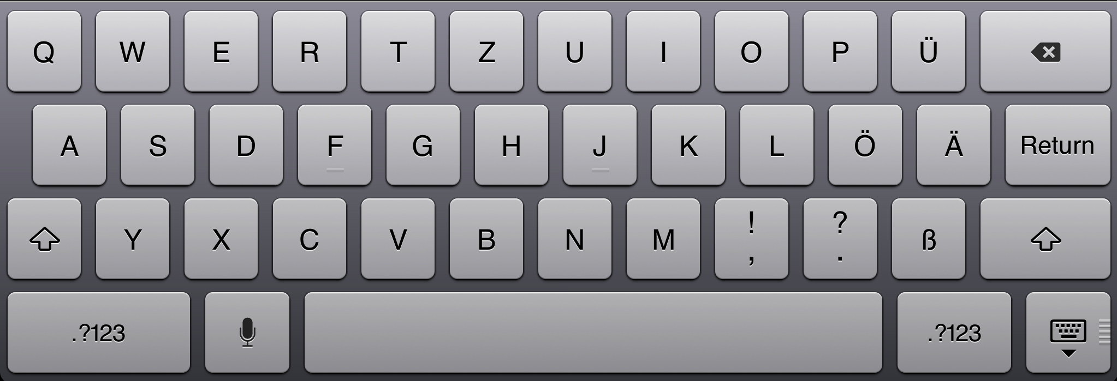
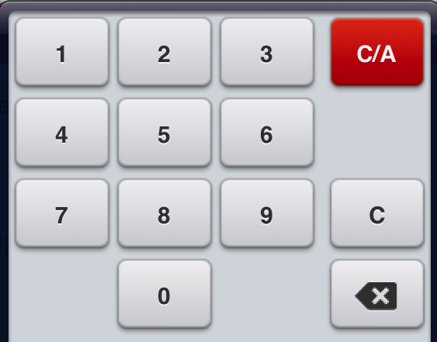
Process Box
Symbol # 2
Process Name
User will be able to write text here. It should be stored in a separate list named as “Process List”. We will use that list in the final comparison
No of Operators
This number will be updated automatically when user will put information about “number of operators” in Data Box, or manually here.

Slide 13
Symbol # 3
Process Box with Information Technology
Department / Function Name
Process Name
User will be able to write text here. It should be stored in a separate list named as “Process List”. We will use that list in the final comparison
Manual /Automatic
Automatic
Manual

Slide 14
Symbol # 4
Shared Process
User will be able to write text here. It should be stored in a separate list named as “Process List”. We will use that list in the final comparison

Slide 15
Data Box
Symbol # 5
CT | Hour : min : sec
+
Hours Mins Sec
CT
C/O
Time Available
Batch Size
Other
00 00 00
01 01 01
02 02 02
03 03 03
Data Box Options
CT: Cycle Time
C/O: Change Over Time
Effective Machine Cycle Time
Scrap Rate
Defect Rate
Uptime
Time Available
Shifts
Operators
Batch Size
Add Other
CT | 30 mins
C/O | 10 mins
Shifts | 2
Availability | 30%
Batch size | 15
+

Slide 16
When ever a process box/process box with technology/Shared Process symbols are added in the map area, A data box should automatically be added under it. User can remove the data box if required.
Process Name
No of Operators
CT | Hour : min : sec
+

Slide 17
Inventory
Symbol # 6
When user tap on inventory, this calculator will be shown to insert inventory value
# Inventory

Slide 18
Push Symbol
Symbol # 7
This arrow symbol will be resized automatically when the attached icons are moved in any direction like in power point

Slide 19
Pull Symbol
Symbol # 8

Slide 20
Production Control Box
Symbol # 9
Production Control

Slide 21
Information Flow 1
Symbol # 10
This arrow symbol will be resized automatically when the attached icons are moved in any direction like in power point. User can write in the box

Slide 22
Information Flow 2 (Electronic Information Flow)
Symbol # 11
This arrow symbol will be resized automatically when the attached icons are moved in any direction like in power point

Slide 23
Time Line Symbols 1 (Non Value Added)
Symbol # 12
Time
Days Hours Mins Sec
00 00 00 00
01 01 01 01
02 02 02 02
03 03 03 03

Slide 24
Time Line Symbols 2 (Value added)
Symbol # 13
Time
Days Hours Mins Sec
00 00 00 00
01 01 01 01
02 02 02 02
03 03 03 03

Slide 25
Time Line Symbols 3
Symbol # 14
Non Value Added Time
Non Value added and value added times will be calculated automatically as user insert their values in time line
Value Added Time

Slide 26
Example
Example: How three symbols will look like when attach to each other
Non Value Added Time = A1+A2+..
Value Added Time = B1+B2+….
Time A1
Time A2
Time A1
Time B1
Time B2

Slide 27
Symbol # 15
Operator

Slide 28
Symbol # 16
Multiple Operators
User can input number of operators
X5

Slide 29
Work cell
Symbol # 17
Step A / Step B / Step C
Example:
User can add text
Step A / Step B / Step C
User can drag and drop operators symbol here

Slide 30
Symbol # 18
Load Leveling
OXOX

Slide 31

Symbol # 19
Phone

Slide 32

Symbol # 20
Production Kanban

Slide 33

Symbol # 21
Withdrawal Kanban

Slide 34

Signal Kanban
Symbol # 22

Slide 35

Kanban Post
Symbol # 23

Slide 36

Sequenced Pull
Symbol # 24

Slide 37
MRP/ERP
Symbol # 25

Slide 38

Go See
Symbol # 26

Slide 39

Verbal Information
Symbol # 27

Slide 40

Kaizen Burst
Symbol # 28
User can write text here

Slide 41
Other Stuff
Symbol # 29
Other information
User can write text here

Slide 42

Rail Shipment
Symbol # 30

Slide 43

Air Freight
Symbol # 31

Slide 44

Expedited
Symbol # 32

Slide 45

Milk Run
Symbol # 33

Slide 46

Warehouse
Symbol # 34

Slide 47

Cross-Dock
Symbol # 35

Slide 48

Orders
Symbol # 36

Slide 49

Betched Kanban
Symbol # 37

Slide 50

Control Center
Symbol # 38

Slide 51
Safety/Buffer Stock
Symbol # 39

Slide 52

Clock
Symbol # 40

Slide 53

Truck Symbol
Symbol # 41
Weekly
Hourly
Weekly
Monthly
Other

Slide 54
Text Box
User can drag and drop this text box up on any symbol, and any where in the map are, and write text. User can also change color/font/size of the text

Slide 55
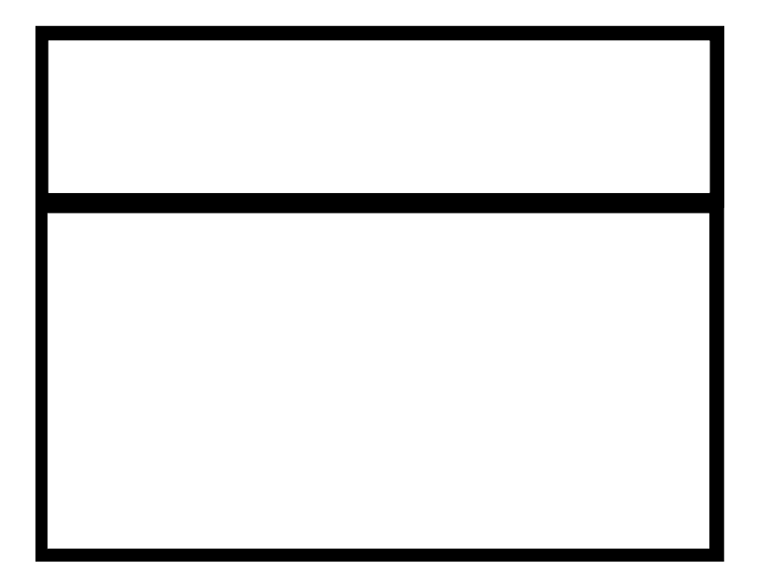



Template
Headquarters
Weekly
Daily Order
Supplier
Customer
Tue + Thu
Daily Order
Daily Order
Weekly
Order
Daily Order
1 X Daily
Total cycle time =
0.522 weeks
Total cycle time =
0.522 weeks
Total cycle time =
0.522 weeks
Total cycle time =
0.522 weeks
Step 1
Step 2
Step 3
Shipping
000
000
000
000
IPLT | 600
P/T | 0
C/O | 100
Availability | 100
Batch size | 15
IPLT | 600
P/T | 0
C/O | 100
Availability | 100
Batch size | 15
IPLT | 600
P/T | 0
C/O | 100
Availability | 100
Batch size | 15
 | 1 day
LEAD
TIME (s) | 42000
VALUE
TIME (s) | 4200
 | 3 days
 |  | 35 Seconds
 | 1 day
 | 35 Seconds
 | 2.35 day
 |  | 35 Seconds

Slide 56
Reports:
VSM Data 1 – Data Boxes of all process steps
 | Step 1 | Step 2 | Step 3 | Step 4 | Step 5
CT | 4 min | 2 min | 5 min | 0.5 min | 20
C/O | 0 | 0 | 0 | 30 | 2
Batch | 1 | 1 | 6 | 10 | 1
# People | 6 | 8 | 1 | 1 | 2
Uptime | 100% | 99% | 88% | 65% | 100%
Quality% | 100% | 90% | 82% | 94% | 98%
CT / Person | 24 | 16 | 5 | 3.5 | 44
Other 1 |  | 3 |  | 5
Other 2 |  |  | 25

Slide 57
VSM Data 2 : Takt Time
Total Demand per day = D
Hours per shift = h
Minutes per hour = m
Minutes for breaks (Break Time) = bt
Total available time = T = (h*m) – bt
Takt Time = Tk= T/D
Example
Total Demand per day = D = 140
Hours per shift = h = 8
Minutes per hour = m = 60
Minutes for breaks (Break Time) = bt = 60
Total available time = T = (h*m) – bt = (8*60)-60=420
Takt Time = Tk= T/D = 420/140 = 3 Min Takt Time

Slide 58
Procurement Lead-Time
Interval of time elapsing between issue of order and goods readiness for production.
Process Lead-Time (Throughput Time)
Interval of time elapsing between moment of availability of input material/components and movement of availability of 1st output product (or quasi-product – or sub-assembly…)
Value-Adding Cycle Time
Referred to repetitive operation: The overall “value-adding” time required to carry out a repetitive processing activity (value-adding time only: excluding all non-value-adding activities)
Manufacturing Cycle Time
Sum of all Cycle-Times necessary to carry out all operations required to manufacture a product
Value-Adding Manufacturing Cycle Time
Sum of all Value-Adding Cycle-Times necessary to carry out all operations required to manufacture a product
Selling Cycle Time (“Pitch Time” – “Takt Time”)
Referred to a production lot: minutes and seconds that “should take” to process parts, quasiproducts or finished products according to amount of D-Time as specified by Customers
TAKT Time = Total Daily Operating Time/Total Daily Requirement

Slide 59
Current State:
User can divide process steps into three categories, and differentiate them with different colors:
Step 1
Value Added Activity
Transforms or shapes material or information
It’s done right the first time
The customer wants it
Step 1
Non-Value Added Activity – Necessary Waste
No value is created, but cannot be eliminated based on current technology, policy, or thinking
Examples: project coordination, regulatory, customer mandate, law
Step 1
Non-Value Added Activity – Pure Waste
Consumes resources, but creates no value in the exes of the customer
Examples: idle/wait time, inventory, rework, excess checkoffs

